Slide 1
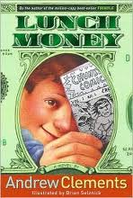
Lunch Money
By,
Andrew Clements
Illustrated by,
Brian Selznick

Slide 2
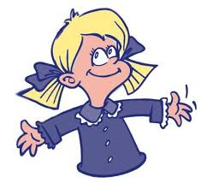
Main Characters
Greg Kenton
Greg is a boy who has good intentions. He is motivated by making money.
Maura Shaw
Maura is a girl who initially annoys Greg. She constantly copies him.

Slide 3
Setting
This story takes place in ash worth intermediate school.

Slide 4
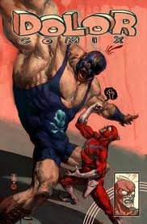
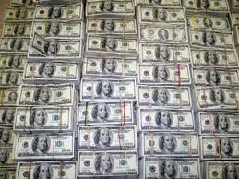
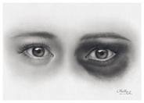
Plot
This story is about a boy named Greg and a Girl named Maura. Greg liked making money and Maura was always copying Greg’s ideas. So one day Greg decided to sell comics at school. So Greg did and after a couple of days passed Greg noticed other books being sold, and as soon as he noticed this Greg already knew it was Maura Shaw. So after recess Greg went to Mr. Z’s math class and once he got there he approached Maura and said “why did you copy my idea.” Maura explained that she didn’t make comics or copy him. They ended up fighting over one of Greg’s comic books and Maura accidently hit him in the eye.

Slide 5
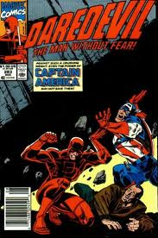
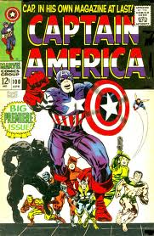
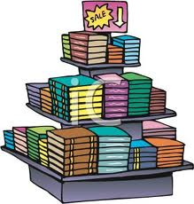
Mr. Z went over to separate the kids and find out what was going on. Mr. Z talked with the kids for a while and was able to sort out their dispute. Greg and Maura decided to work together and start a comic book business. With Mr. Z’s help they made a business plan and presented it to the principle who at first was against the idea because she didn’t like comic books. After some persuasion the principle agreed to Greg’s and Maura’s business named Chunky Comics.

